Slide 1
DevOps Foundations: Version Control and CI/CD with Jenkins

Slide 2
Version Controlling in DevOps

Slide 3
Utilize a version control system to identify and understand its key components for tracking changes in software projects
Create and clone GitHub repositories to understand the fundamentals of repository management and version control
Use the git push command to upload changes from a local repository to a remote Git repository
Create a pull request to propose merging the changes into a remote GitHub codebase

Slide 4
Apply branching and merging techniques to facilitate simultaneous collaboration in project development
Utilize the Git commands to create and switch to a new branch simultaneously to streamline a Git workflow
Assess and resolve basic merge conflicts in a version control system by addressing the differences between conflicting code blocks

Slide 5
Overview of Version Control System
Notes:
Instructor Note:
Let us learn what is meant by a version control system and its features.

Slide 6
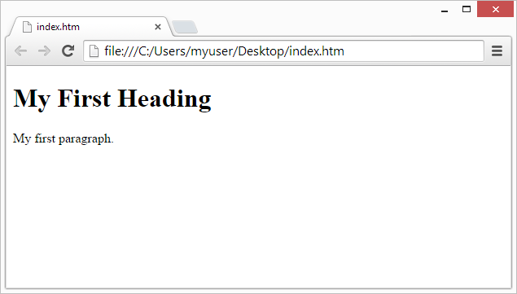
What Is a Version Control System (VCS)?
It is a system that records changes to a set of files over a period to recall specific versions. It is used to store every version of an image or layout.
Example:
Version 1
Version 2
Version 3
Created
Modified
Modified
Notes:
Instructor Note:
Version Control System is a system that records changes to a file or set of files over time so that specific versions can be recalled later. VCS is essential in software development and various other fields where tracking changes to documents or files is necessary.
Key features and functions of VCS include:
Version Tracking
Branching and Merging
Collaboration
Backup and Restore
History and Audits

Slide 7
Advantages of VCS
Some benefits of version control systems are:
Restoring previous versions Revert to earlier versions of files or code
Storing versions Track the changes and maintain a history of revisions
Collaborating Facilitate teamwork by allowing multiple users to work on the same files
Code evolution Gain insights into the evolution of code or files through version history
Backing up Ensure data safety by having backups of all versions stored in the system
Notes:
Instructor Note:
Restoring Previous Versions
Use Case: Fixing mistakes or experimenting with new features without losing stable versions.
2. Storing Versions
Use Case: Keeping a historical record for accountability and understanding contributions.
3. Collaborating
Use Case: Enabling simultaneous work and resolving conflicts in team projects.
4. Code Evolution
Use Case: Understanding development progress and auditing changes for quality control.
5. Backing Up
Use Case: Protecting against data loss and enabling recovery in case of issues

Slide 8
Key Concepts of a VCS
Repository: Maintain a central location that stores and displays all project versions
and history
Branching: Enable parallel development for multiple versions of a project to coexist
Tagging: Create named markers for specific points in the project history
Merging: Combine changes from one branch into another
Commit: Save changes into the version history with a description
Cloning: Create a local copy of a remote repository
Notes:
Instructor Note:
Repository
Use Case: Centralized storage for code and history, enabling access and collaboration.
2. Branching
Use Case: Allows developers to work on different features or fixes simultaneously without affecting the main codebase.
3. Tagging
Use Case: Useful for marking release points, milestones, or significant updates in the project.
4. Merging
Use Case: Integrates different branches' changes into a single branch, ensuring all updates are incorporated.
5. Commit
Use Case: Record the state of the project at a specific point, providing a history of changes and the rationale behind them.
6. Cloning
Use Case: Allows developers to work on the project locally, making changes and updates before pushing back to the central repository.

Slide 9
Key Concepts of a VCS
Forking: Create an independent copy of a repository
Pull request: Propose changes to merge from one branch or fork into another
Annotate: Identify who made specific changes in the code
Rollback or Revert: Return to a previous state of the codebase
Stash: Save changes temporarily that are not ready for committing
Changelog: Document all the changes made to a project
Notes:
Instructor Note:
1. Forking
Use Case: Used for experimenting with changes without affecting the original repository, often used in open-source contributions.
2. Pull Request
Use Case: Facilitates code review and collaboration, allowing team members to discuss and approve changes before merging.
3. Annotate
Use Case: Helps in tracking authorship and understanding the history behind each change, useful for debugging and accountability.
4. Rollback or Revert
Use Case: Used to undo changes that introduced errors or bugs, ensuring stability by reverting to a known good state.
5. Stash
Use Case: Allows developers to save their work-in-progress changes without committing them, enabling context switching without losing progress.
6. Changelog
Use Case: Provides a detailed record of what changes were made, why they were made, and who made them, aiding in project transparency and communication.

Slide 10
Role of VCS in DevOps Lifecycle
VCS enables seamless integration, faster recovery, and collaboration in the DevOps lifecycle.
Below are the phases of the DevOps lifecycle where VCS plays a crucial role:
01
Planning phase: Organize tasks and document progress to track changes and maintain version history
Planning Phase
02
Design Phase
Development Phase
Testing Phase
Release Phase
Support Phase
Design phase: Facilitate collaboration on software blueprints, design, and iterate system architecture
03
Development phase: Manage code, version control, and collaboration among developers during coding and testing
Notes:
Instructor Note:
Planning Phase:
Define project requirements, organize tasks, and document progress.
Collaborate on feature planning, user stories, and project timelines.
Establish clear communication channels and roles within the team.
Design Phase:
Create software blueprints, design user interfaces, and define system architecture.
Collaborate with stakeholders to gather feedback and iterate on designs.
Ensure alignment between design goals, user needs, and technical feasibility.
Development Phase:
Write code, conduct unit testing, and integrate code changes with the team.
Collaborate on coding standards, version control, and code review processes.
Address technical debt, refactor codebase, and optimize for performance.

Slide 11
Role of VCS in DevOps Lifecycle
Below are the phases of the DevOps lifecycle where VCS plays a crucial role:
04
Testing phase: Track code changes, manage test scripts, and ensure test coverage for software testing
05
Development Phase
Testing Phase
Release Phase
Support Phase
Release phase: Prepare for deployment, tag versions, and manage release branches for deployment activities
06
Support phase: Manage bug fixes, track issues, and maintain code stability post-deployment for ongoing support and maintenance
Notes:
Instructor Note:
Testing Phase:
Create and execute test cases to validate software functionality and performance.
Conduct automated testing, regression testing, and performance testing.
Collaborate with developers to fix bugs, optimize code, and improve test coverage.
Release Phase:
Prepare software for deployment, manage release processes, and coordinate rollouts.
Conduct user acceptance testing (UAT), final testing, and readiness assessments.
Collaborate with operations teams for deployment planning, monitoring, and support.
Support Phase:
Monitor software performance, manage issues, and provide ongoing support.
Collaborate with stakeholders to prioritize and resolve reported issues.
Conduct post-mortems, gather feedback, and iterate on product improvements.

Slide 12
Types of VCS
There are three main types of version control systems:
Local version control systems
Central version control systems
Distributed version control systems
For storing changes locally before pushing them to a single code version
For hosting various code versions in a central repository to access and manage changes
For mirroring the central repository history in each local repository to ensure robustness for easy retrieval
Notes:
Instructor Note:
Local version control systems store changes locally before pushing them to a single code version, posing challenges in retrieval if corruption occurs.
Central version control systems host various code versions in a central repository, enabling users to access and manage changes, albeit with difficulties in retrieval if the central repository is corrupted.
Distributed version control systems mirror the central repository's history in each local repository, ensuring robustness as any local server can provide a copy of the repository and history, even in case of central repository issues.

Slide 13
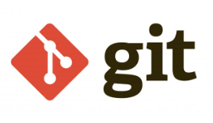

Tools for VCS
Here are some of the most widely used VCS tools:
Notes:
Instructor Note:
Git
Git is among the most powerful version control programs now on the market. The creator of Linux, Linus Torvalds, created the distributed version control system known as Git. Its memory footprint is minimal and can follow changes in any file. When you add this to its extensive feature set, you get a full-featured version control system that can handle any project. Due to its simple workflow, it is employed by Google, Facebook, and Microsoft.
GitHub
Software development teams may collaborate and keep track of all code changes using GitHub. You can keep track of code modifications, go back in time to correct mistakes, and collaborate with other team members. The most reliable, secure, and scalable developer platform in the world is GitHub. You receive the best resources and services to assist you in creating the most cutting-edge communities possible. The most reliable, secure, and scalable developer platform in the world is GitHub.
Bitbucket
As a component of the Atlassian software family, Bitbucket can be connected with other Atlassian products like HipChat, Jira, and Bamboo. Some of Bitbucket’s key features are code branches, in-line comments and debate, and pull requests. The company’s data center, a local server, or the cloud can all be used for its deployment. With Bitbucket, you can freely connect with up to five people. This is advantageous because you can use the platform without spending any money.
GitLab
GitLab is a web-based Git repository that provides free open and private repositories, issue-following capabilities, and wikis. It is a complete DevOps platform that enables professionals to perform all the tasks in a project—from project planning and source code management to monitoring and security. Additionally, it allows teams to collaborate and build better software.

Slide 14

Overview of VCS Tools
Git is a version control system for tracking code file changes and is generally used for source code management in software development.
Employs distributed version control system
Minimizes memory footprint
Manages changes in any file
Is utilized by major companies like Google, Facebook, and Microsoft
Notes:
Instructor Note:
Git as a VCS Tool
Distributed System: Git employs a distributed version control system.
Memory Efficient: Minimizes memory footprint.
File Management: Manages changes in any file.
Widely Used: Utilized by major companies like Google, Facebook, and Microsoft.

Slide 15

Overview of VCS Tools
GitHub provides a web-based Git repository hosting service that provides a web interface to
upload files.
Facilitates code collaboration and version control
Tracks code modifications and history
Allows correction of mistakes by reverting changes made to the codebase
Supports collaboration among team members
Notes:
Instructor Note:
GitHub as a VCS Tool
1. Facilitates Code Collaboration and Version Control
Description: GitHub provides a platform for developers to collaborate on code. It integrates with Git to manage version control effectively.
Benefit: Enhances team collaboration, allowing multiple developers to work on the same project seamlessly.
2. Tracks Code Modifications and History
Description: GitHub records all changes made to the codebase, maintaining a detailed history of modifications.
Benefit: Ensures transparency and accountability, making it easier to track changes, understand project evolution, and identify the contributions of different team members.
3. Allows Correction of Mistakes by Reverting Changes Made to the Codebase
Description: Developers can revert changes to previous states if mistakes are identified.
Benefit: Provides a safety net to undo errors, ensuring that the codebase remains stable and functional.
4. Supports Collaboration Among Team Members
Description: GitHub supports features like pull requests, code reviews, and issue tracking to facilitate collaboration.
Benefit: Improves communication and coordination among team members, promoting best practices like peer reviews and continuous integration.

Slide 16
Overview of VCS Tools
Bitbucket is a professional Git repository management solution for teams, centralizing repository management, source code collaboration, and development guidance.
Offers code collaboration platform by Atlassian
Supports code branches for parallel development
Allows in-line comments and debate for code review
Enables pull requests for code contribution and review
Notes:
Instructor Note:
Bitbucket as a VCS Tool
1. Code Collaboration Platform
Description: Bitbucket offers a code collaboration platform by Atlassian.
Benefit: Centralizes repository management and enhances team collaboration.
2. Supports Code Branches for Parallel Development
Description: Enables the creation of multiple branches for parallel development.
Benefit: Facilitates isolated feature development and concurrent work streams.
3. In-line Comments and Code Review
Description: Allows in-line comments and debates on code changes.
Benefit: Enhances the quality of code through peer reviews and discussions.
4. Pull Requests for Code Contribution and Review
Description: Supports pull requests for proposing and reviewing code changes.
Benefit: Streamlines the process of merging contributions into the main codebase, ensuring code quality and collaboration.

Slide 17
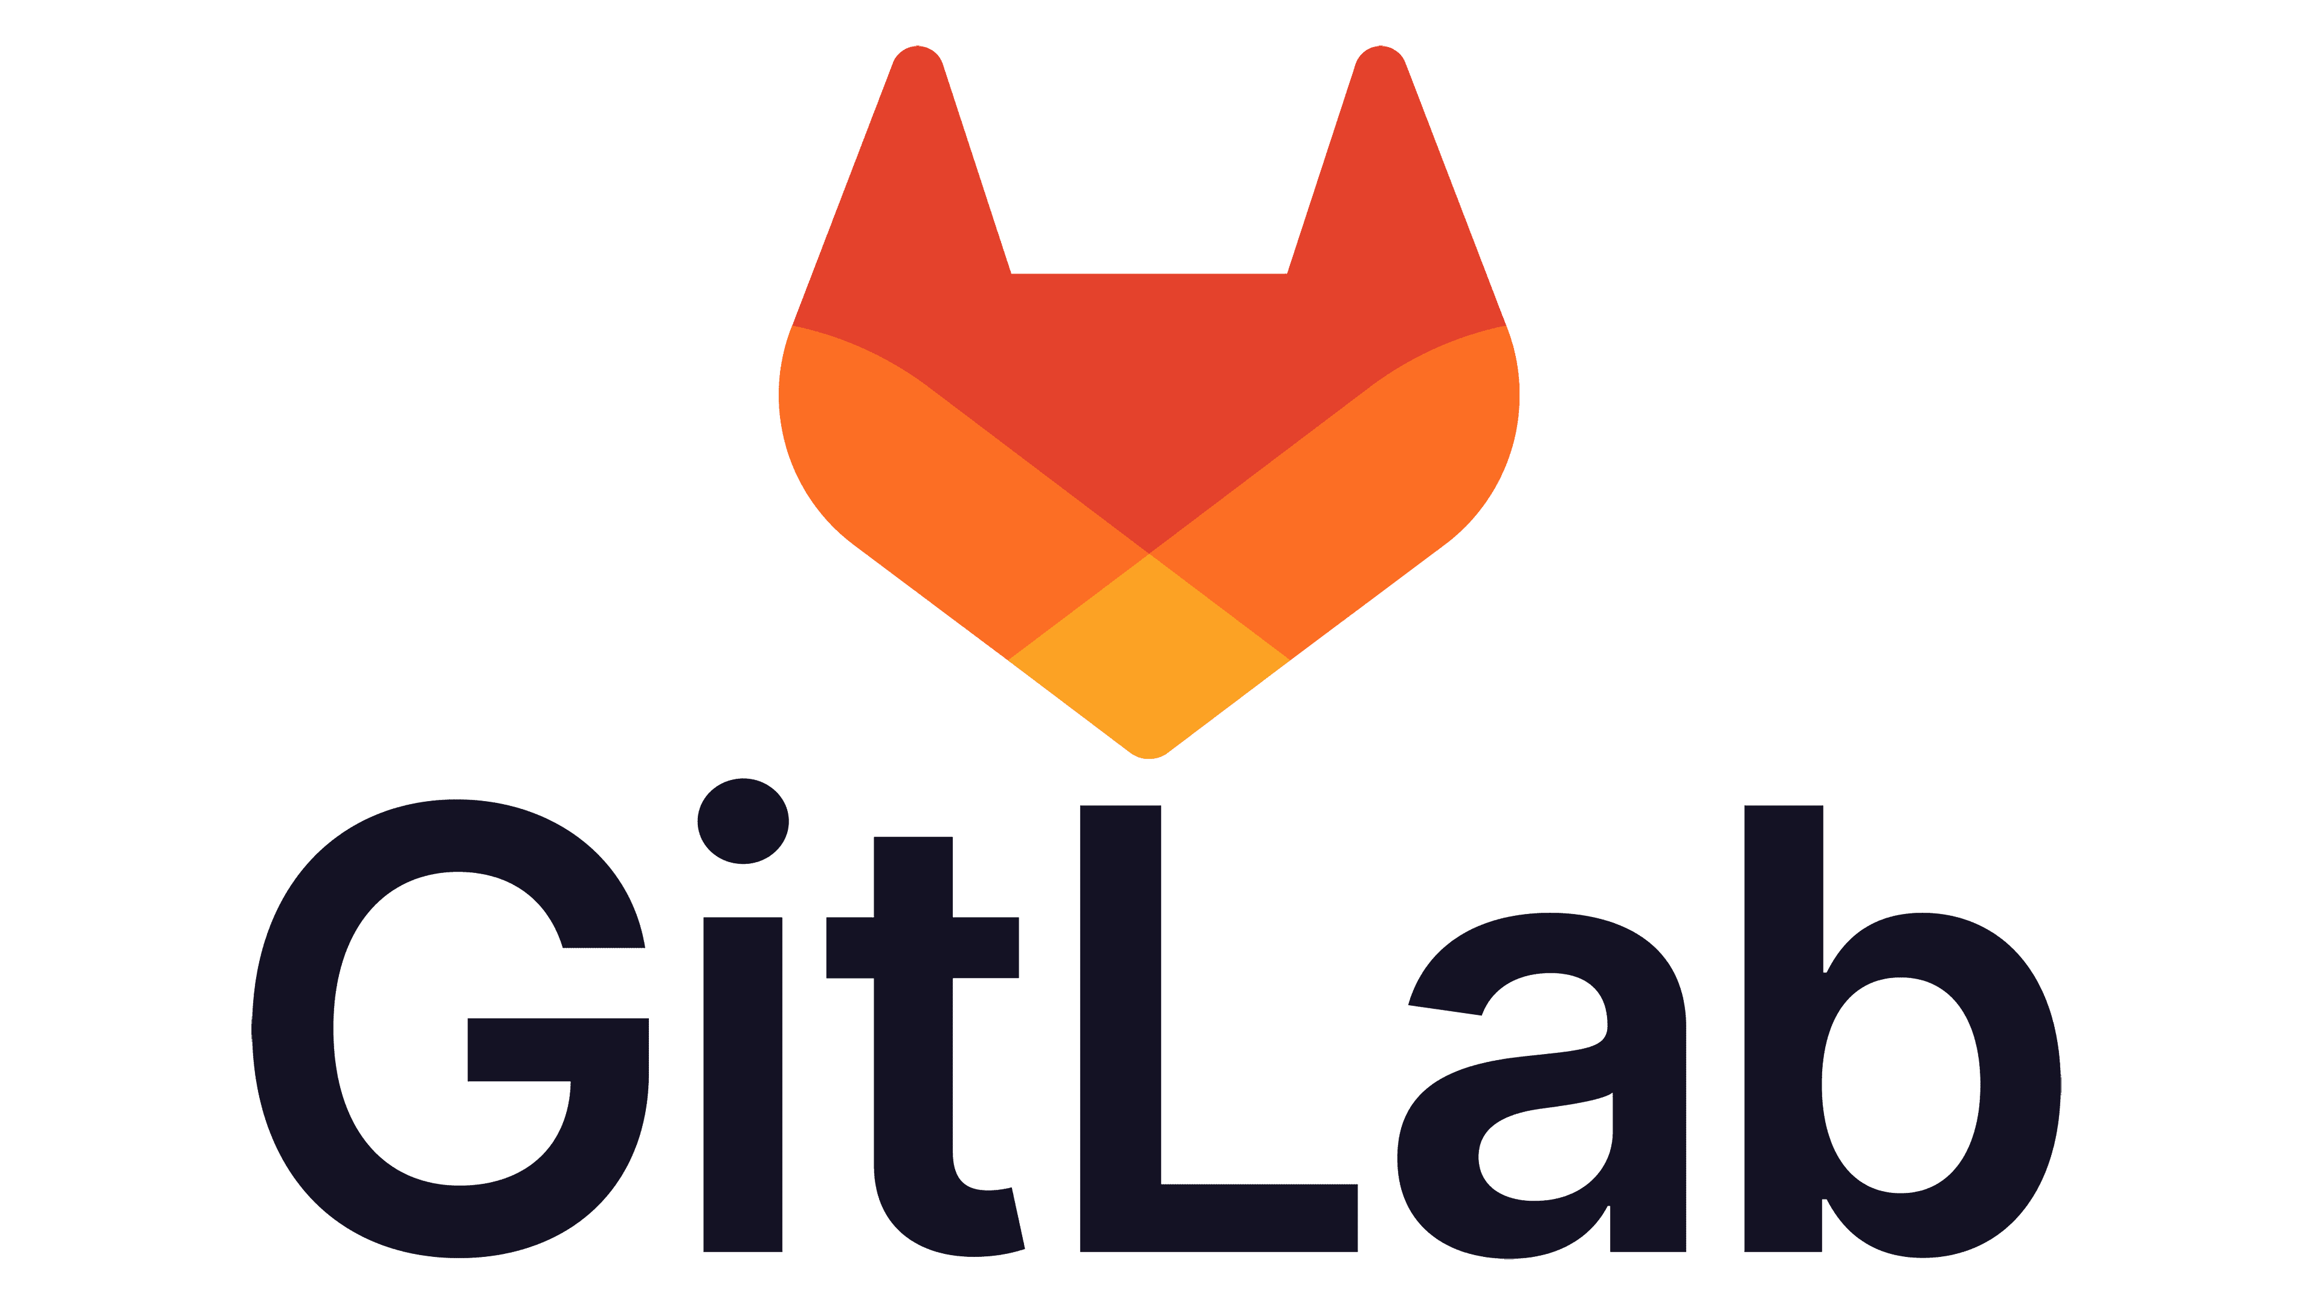
Overview of VCS Tools
GitLab is a service that provides remote access to Git repositories.
Provides internal management of git repositories
Keeps the user code private
Deploys the change on the user code
Provides user-friendly web interface layer
Notes:
Instructor Note:
GitLab as a VCS Tool
1. Internal Management of Git Repositories
Description: GitLab provides robust internal management tools for handling Git repositories.
Benefit: Streamlines repository management and integrates with other DevOps tools.
2. Privacy of User Code
Description: Keeps the user code private.
Benefit: Ensures that sensitive or proprietary code is secure and accessible only to authorized users.
3. Deployment of Code Changes
Description: Facilitates the deployment of changes on the user code.
Benefit: Supports continuous integration and continuous deployment (CI/CD) pipelines, automating the deployment process.
4. User-Friendly Web Interface
Description: Provides a user-friendly web interface layer.
Benefit: Enhances usability and accessibility, making it easier for developers to interact with the platform and manage their projects.

Slide 18

Version Control: Best Practices
Best practices for implementing version control systems:
Commit code changes granularly with clear messages
Utilize branches for managing software versions and patches
Ensure compliance with disaster recovery and access control measures
Backup the version control repository to prevent data loss in case of emergencies
Monitor and audit version control activities to ensure security and integrity of codebase
Notes:
Instructor Note:
Choose the Right VCS: Pick a VCS tool that fits your team's needs, like Git or SVN.
Keep Your Code Safe: Use a VCS that lets you save your code online and keeps track of changes.
Organize Your Folders: Arrange your code folders neatly so everyone can find what they need easily.
Work on Separate Copies: Create copies of your code when you're working on new features or fixing bugs. Merge them back when they're ready.
Explain Your Changes: When you save your work in the VCS, write a short note explaining what you did. This helps others understand your changes.
Check Your Code: Have someone review your code changes before they get added to the main code. It helps catch mistakes early.
Ignore Unnecessary Files: Tell the VCS to ignore files that don't need to be saved, like temporary files or settings specific to your computer.
Backup Your Work: Make copies of your code regularly to avoid losing it. Have a plan in case something goes wrong.

Slide 19
In development environment, which tool is chosen for streamlined code management and collaboration, serving as a version control system (VCS) across projects?
Java
Git
Visual Studio
Docker
Notes:
Mode: Sync
Estimated duration: 5 minutes
Instructor Note:
Conduct the poll and, if necessary, reteach key points based on the results before starting with the next topic.
Provide feedback or explanations after the poll, where appropriate, so learners can understand why certain answers are correct or incorrect.
If most of the class is getting the poll incorrect, then there is a gap in their understanding. Prompt the learners to highlight which concepts are unclear to them and teach those topics for the understanding of the whole class. Move onto the next topic when the class is confident in their understanding of the section.
Correct Answer: B) Git
Explanation: Git is a widely used version control system (VCS) designed for tracking changes in code repositories and facilitating collaboration among developers.

Slide 20
Introduction to Git as a VCS
Notes:
Instructor Notes:
Let us now introduce Git as a VCS

Slide 21

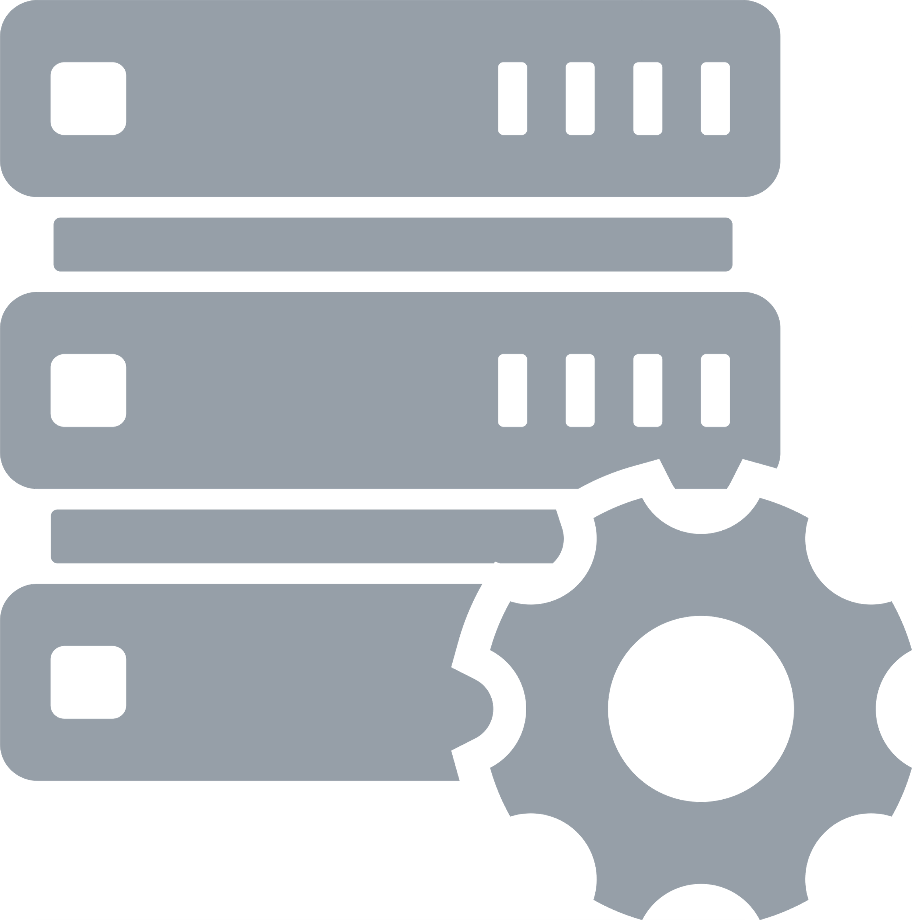





What Is Git?
Git is an open-source distributed version control system used for tracking changes in source code during software development.
Git
Developers
Git server
It allows multiple developers to work on the same project simultaneously, facilitating collaboration and enabling efficient management of changes to the codebase.
Notes:
Instructor Note:
Git has become an essential tool for software development teams worldwide, providing a robust platform for collaboration, version control, and project management. It is commonly used alongside platforms like GitHub, GitLab, and Bitbucket, which offer additional features such as hosting repositories online, issue tracking, and code review tools.

Slide 22


Purpose of Using Git
Track changes and revert to
previous versions
Allow collaboration without conflicts
Provide branching and
merging feature
Manage the development of large projects efficiently
Notes:
Instructor Note:
There are several key purposes for using Git:
Track Changes and Revert to Previous Versions: Git acts like a time machine for your project. It keeps a record of every modification made to your files, allowing you to see exactly what changed, who made the changes, and when. This makes it easy to revert back to a previous version if something goes wrong or you decide you prefer an older iteration.
Collaboration: Git excels at facilitating teamwork on projects. Multiple developers can work on different parts of the codebase simultaneously without worrying about conflicts. Git allows you to merge changes from different versions and keep everyone on the same page.
Branching for Feature Development: Git's branching feature is a powerful tool. It lets developers create isolated working environments to experiment with new features or bug fixes without affecting the main project code. This promotes safe development and a clear separation of concerns.
Efficiency and Scalability: Git is efficient at handling large projects. Its distributed nature avoids bottlenecks that can occur with centralized version control systems. This makes it a perfect choice for complex software development efforts.
In summary, Git provides a robust system for tracking changes, enabling collaboration, fostering safe development practices, and efficiently managing software projects.

Slide 23

Features of Git
Keeps track of every change
Is open source
Is secure
Is a distributed version control system
Provides a
staging area
Supports non-linear development
Is scalable
Enables branching
and merging
Notes:
Instructor Notes:
Here are some of the key features of Git that make it a powerful version control system:
Distributed Version Control: Unlike centralized systems, Git doesn't rely on a single server. Every developer working on the project has a complete copy of the entire history on their machine. This allows for offline work and more flexibility in collaboration.
Branching and Merging: Git enables creating and managing branches of the codebase. This allows for parallel development on different features or bug fixes. Branches can be easily merged back into the main codebase when ready.
Tracking History: Git meticulously keeps track of every change made to the project files. You can see who made a specific change, when it was made, and the exact details of the modification. This detailed history allows for easy rollbacks to previous versions if necessary.
Staging Area: Git provides a staging area, which acts like a buffer zone before committing changes. You can add specific files or portions of code to the staging area before creating a commit, allowing for more control over what gets included in each version snapshot.
Lightweight and Efficient: Git is known for its speed and efficiency, even for handling large projects. This is because it only stores the differences between versions of files instead of entire file copies.
Open Source and Free: Git is an open-source software, freely available for anyone to use and contribute to. This allows for a large and active developer community constantly improving the tool.
Scalability: Git scales well with the size and complexity of your project. Its distributed nature avoids the limitations of centralized systems that can struggle with massive projects.

Slide 24


Git vs. GitHub
Git
GitHub
It is a version control system installed on the local system.
It has a command line interface (CLI).
It tracks changes in files locally.
It offers no built-in user management.
It is free and open-source.
It is a web-based online Git hosting service.
It has both GUI and CLI.
It tracks changes by hosting Git repositories.
It offers built-in user management and access control.
It has a free tier with paid plans for additional features.
Notes:
Instructor Note:
Git: Imagine Git is a powerful tracking system for your project's files. It runs locally on your machine, keeping a history of changes and allowing you to revert to previous versions. It's like a time machine for your code.
GitHub: GitHub is an online storage locker for your Git projects, also known as repositories. It provides a user-friendly interface, collaboration tools, and cloud storage for your Git repositories. Multiple people can work together on projects hosted on GitHub.
In essence, Git is the engine that tracks changes, while GitHub provides a user-friendly platform to store and collaborate on those Git-tracked projects.

Slide 25

Git Lifecycle
Remote repository
Clone operation
Working copy
Update
operation
Edit, add, and move files
Modify working copy
Status and difference operation
Review changes
Commit and push operation
Push operation
Commit changes
Amend and push operation
Push operation
Fix mistakes
Notes:
Instructor Note:
Here’s a breakdown of the general Git workflow, incorporating pushing changes to a remote repository:
Clone: The process begins by cloning an existing Git repository. This creates a working copy of the repository on your local machine.
Working Directory: This is your local copy of the repository where you can make changes to the files.
Modify Working Copy: You can edit, add, or move files within the working directory as needed.
Status and Difference Operation: Git commands like ‘git status’ can help you see which files have been modified, added, or deleted in your working directory.
Staging Area: The staging area acts as a temporary holding space for changes you want to include in your next commit. You can use the ‘git add’ command to stage specific files or changes.
Commit Changes: The ‘git commit’ command captures the staged changes along with a descriptive commit message. This creates a snapshot of the project’s state at that point in time.
Push Operation: Once you’ve committed your local changes, you can push them to a remote repository, typically hosted on a platform like GitHub. The ‘git push’ command uploads those changes to the remote repository.
Additionally, there are:
Update Operation: You can pull down updates from the remote repository to keep your local working directory in sync with the latest changes from other collaborators.
Amend and Push: This allows you to modify an existing commit message if needed before pushing the changes.

Slide 26







Companies Using Git
Notes:
Instructor Note:
Companies Using Git
Adoption by Major Companies: Git is widely adopted by leading technology companies such as Google, Netflix, Microsoft, LinkedIn, Adobe, Facebook, and Dell.
Purpose: These companies use Git to manage source code, collaborate on development projects, and streamline their continuous integration and deployment processes.
Benefits: Git helps these organizations maintain code quality, manage version control efficiently, and facilitate collaboration among distributed development teams.

Slide 27
Basic Git Commands
Below are some commonly used Git commands that can perform various version control tasks: ​
Operation | Command
Configures the username and email address | git config --global user.name “testusername"​ git config --global user.emailtestname@example.com
Initializes a new Git repository in the current directory | git init
Creates a copy of a remote Git repository on a local machine | git clone [repository URL]
Commits stage changes | git add [filename]
Notes:
Instructor Note:
Basic Git Commands
Configuring User Information: The command git config --global user.name "testusername" and git config --global user.email "user.emailtestname@example.com" are used to set the global username and email address for Git configurations. This ensures that all commits are associated with the correct user information.
Initializing a Repository: git init initializes a new Git repository in the current directory, setting up the necessary Git structures for version control.
Cloning a Repository: git clone [repository URL] creates a copy of a remote Git repository on the local machine, allowing you to work on the project locally.
Committing Changes: git add [filename] stages changes, preparing them for a commit, which records the changes in the repository’s history.

Slide 28
Basic Git Commands
Operation | Command
Commits all stage changes at once | git add .
Records staged changes with a descriptive message | git commit -m "[commit message]"
Shows the status of your working directory | git status
Fetches changes from a remote repository and integrates them into the current branch | git pull
Uploads local branch changes to a remote repository | git push
Links local repository to a remote one | git remote add [remote name] [remote URL]
Notes:
Instructor Note:
Basic Git Commands
Committing All Staged Changes: The command git add . stages all changes in the current directory for the next commit. Following this, git commit -m "[commit message]" records these changes with a descriptive message, adding them to the repository’s history.
Checking Status: git status shows the status of your working directory and staging area, helping you keep track of changes that have been staged, modified, or untracked.
Fetching and Integrating Changes: git pull fetches changes from a remote repository and integrates them into your current branch, ensuring your local repository is up-to-date.
Pushing Changes: git push uploads local branch changes to a remote repository, allowing others to access your updates.
Linking Remote Repositories: git remote add [remote name] [remote URL] links your local repository to a remote one, enabling collaboration and synchronization with remote team members.

Slide 29
Basic Git Commands
Operation | Command
Retrieves changes from a remote repository but doesn't merge them | git fetch
Shows a list of remote repositories associated with the current project | git remote -v
Combines changes from the specified branch into the current branch | git merge [branch name]
Lists all branches in the repository, highlighting the current branch | git branch
Displays a chronological list of commits with their details | git log
Creates a named reference to a specific commit, often used for versioning | git tag [tag name]
Notes:
Instructor Note:
Retrieving Changes: git fetch retrieves changes from a remote repository without merging them, allowing you to review updates before integrating them.
Listing Remote Repositories: git remote -v shows a list of remote repositories associated with the current project, useful for managing remote connections.
Merging Branches: git merge [branch name] combines changes from the specified branch into the current branch, facilitating the integration of new features or fixes.
Branch Management: git branch lists all branches in the repository, highlighting the current branch, helping you navigate and manage different development efforts.
Viewing Commit History: git log displays a chronological list of commits with their details, providing a history of changes and aiding in tracking project progress.
Creating Tags: git tag [tag name] creates a named reference to a specific commit, often used for versioning and marking release points in the project.

Slide 30



Git Configuration Level
Git configuration levels define the scope for which specific settings apply. Following are the three
main levels:
--system
Command: git config --system
--global
Command: git config --global
--local
Command: git config --local
NOTE
Local overrides global and global overrides system level.
Local overrides Global and Global overrides System Level.
Notes:
Instructor Note:
Git configuration levels define the scope for which specific settings apply. There are three main levels:
Local: This level is specific to a single Git repository. Settings defined here take precedence over global and system configurations. The configuration file is stored within the repository directory at .git/config.
Global: This level applies to the currently logged-in user across all their repositories. It's ideal for maintaining consistent personal preferences across projects. The configuration file is typically located in the user's home directory at ~/.gitconfig (tilde representing the home directory).
System-wide: This level applies to all users and repositories on the entire system. It's generally used for system-wide defaults and requires administrative privileges to modify. The configuration file is usually located at /etc/gitconfig on Unix-based systems.
These levels provide a hierarchy, where local settings override global settings, which in turn override system-wide settings. This allows you to have specific configurations for individual projects while maintaining consistent defaults for your user or the entire system.

Slide 31
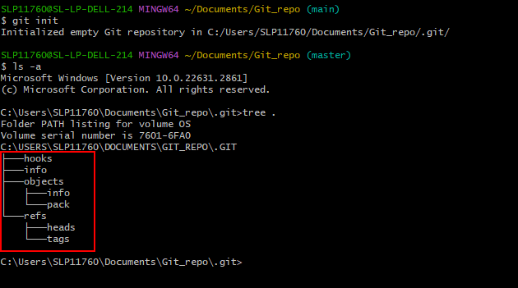
Git Repositories
A Git repository is a central storage location that keeps track of changes made to a set of files. It is initialized using the command git init inside the project directory.
Whenever a Git repository is initialized, a hidden .git folder is created inside the project directory that contains several sub-directories for version controlling:
Notes:
Instructor Note:
A Git repository is essentially a storage location that keeps track of changes made to a set of files. It's like a version control system specifically designed for software development projects. Here's a breakdown of how it works:
Centralized Storage: Imagine a central location where all the project files and their revision history are stored. This is the core of a Git repository. It can reside on your local machine or on a remote server like GitHub.
Tracking Changes: Whenever you modify a file in your project, the Git repository takes a snapshot of those changes. This allows you to see how the files have evolved over time.
Version Control: With each modification, a new version of the file is created within the repository. This enables you to revert back to previous versions if needed, ensuring you don't lose track of progress.
Collaboration: Git repositories become especially useful when multiple people are working on the same project. The repository allows everyone to see the changes made by others, avoid conflicts, and merge their work seamlessly.
In essence, a Git repository acts like a time machine for your project, keeping a record of every change and enabling you to collaborate effectively with others.

Slide 32
Git Repositories
The .git folder contains all necessary data regarding commits, remote repository addresses, and so on.
Following are some important sub-directories:
hooks
This folder contains scripts that run at specific points of a Git workflow.
objects
This folder acts as an object database of Git that stores all the different versions of files.
This folder stores references to specific commits and branches.
refs
HEAD
The files contain references to the current branch of a Git repository.
index
This file stores staging information in a binary form.
Notes:
Instructor Notes:
Here's what's inside the .git folder:
Objects: This folder holds compressed snapshots of your project's files at every commit point. These snapshots are like the building blocks that Git uses to reconstruct the history of your project.
Refs: This folder stores references to specific commits and branches within your repository. It acts like an address book, allowing Git to quickly locate the different versions of your project.
Config: This file stores configuration settings specific to your local Git repository.
Hooks: This folder (optional) allows you to add custom scripts that run at specific points in the Git workflow, like before a commit or after a pull.
Logs and Index: These files help Git maintain an internal record of changes and the current state of your project.
While you can technically look inside the .git folder using your file explorer, the contents are not meant to be human-readable. They are encoded with unique identifiers and compressed for efficiency. It's recommended to use Git commands to interact with the information stored within the .git folder.
Here are some key points to remember about the .git folder:
It is hidden by default in most operating systems to avoid accidental modification.
You don't typically need to edit the files inside it directly. Git commands handle managing the repository for you.
When you push your project to a remote repository like GitHub, only the essential data from the .git folder (objects and refs) is transferred, not the entire folder itself.
In summary, the .git folder acts as the invisible backbone of your Git repository, silently tracking changes and keeping your project history safe.

Slide 33
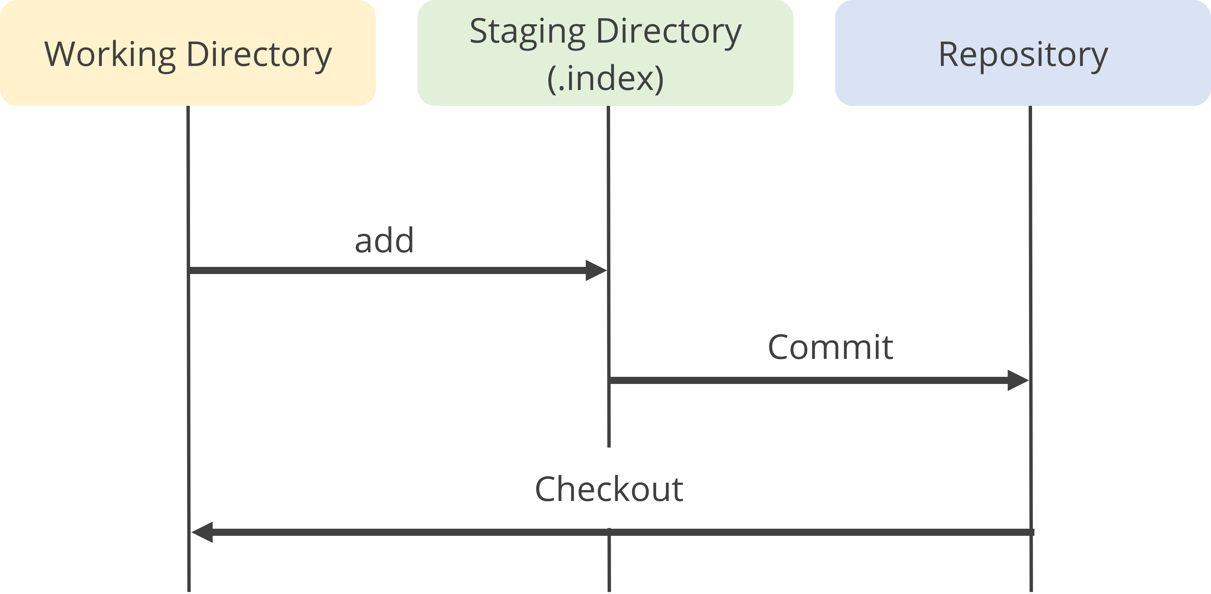
Git Index
The Git index is the staging area or cache that acts as an intermediate zone between the working directory and the Git repository. It is a stage to select and review the changes before commit.
Basic workflow of file handling using Git index:
The files are modified in the working directory.
The git add command is used to stage those modified files.
The git commit command is used to capture the staged changes permanently in the repository.
Notes:
Instructor Note:
The working directory is a single checkout of one version of the project. These files are pulled out of the compressed database in the Git directory and placed on disk for you to use or modify.
The staging area is a file, generally contained in your Git directory, that stores information about what will go into your next commit. Its technical name in Git parlance is the “index”, but the phrase “staging area” works just as well.
The Git directory is where Git stores the metadata and object database for your project. This is the most important part of Git, and it is what is copied when you clone a repository from another computer.

Slide 34
Creating a Local Git Repository
The following are the steps to create local Git repository:
Install Git in your system
Open the terminal
Use the mkdir command to create a new project directory
Use the cd command to navigate into the project directory
Use the git init command to initialize the Git repository
Verify the creation of the repository by looking for the hidden .git folder
Notes:
Instructor Note:
Here are the steps to create a local Git repository:
1. Create a Project Directory:
Open your terminal or command prompt.
Use the mkdir command to create a new directory for your project
2. Navigate to the Directory:
Use the cd command to change directory to the newly created project folder
3. Initialize the Git Repository:
This step creates the essential Git repository files.
4. Verify the Repository (Optional):
You can verify the creation of the repository by looking for a new hidden folder named .git inside your project directory.

Slide 35
Creating a Remote GitHub Repository
Following are the steps to create a remote GitHub repository:
Log in to your GitHub account
Click on Create New > New Repository
In the Create a new repository page, enter the repository details
Choose the option to create private or public repository
Add the optional README file
Click the Create repository button
Notes:
Instructor Note:
Using the GitHub Web Interface:
Log in to GitHub: Go to https://github.com/ and sign in with your account.
Click "New repository" button: In the top right corner, click the "+" button and select "New repository".
Fill in repository details: Give your repository a descriptive name, optionally add a short description, and choose the desired visibility (public or private).
Initialize with README (Optional): You can choose to initialize the repository with a README.md file, which is a great place to add information about your project.
Create repository: Click the "Create repository" button.

Slide 36
Cloning a Remote Git Repository
It is the process of creating a copy of an existing repository from a remote server onto the local machine to get a local repository.
hello
git clone
cloned_hello
Original repository
Copy of original repository
This local repository is not linked with the main remote repository; hence, it is not synchronized with the main repository until done manually.
Notes:
Instructor Notes:
Cloning refers to creating a complete copy of an existing remote repository on your local machine. This allows you to work with the files and track changes locally without affecting the original repository.

Slide 37
Assisted Practice
Duration: 10 Min.
Creating and cloning a GitHub repository
Problem statement:
You have been assigned a task to create and clone a GitHub repository for understanding the fundamentals of repository management and version control using Git and GitHub.
Outcome:
By completing this demo, you will gain comprehensive knowledge of the fundamentals of repository management and version control using Git and GitHub.
Note: Refer to the demo document for detailed steps
Notes:
Instructor Notes:
Refer to the demo document for detailed steps

Slide 38
Assisted Practice: Guidelines
Steps to be followed:
Create a new GitHub repository
Clone the GitHub repository
Notes:
Instructor Notes:
Refer to the demo document for detailed steps

Slide 39
You are collaborating on a project stored in a remote GitHub repository. Although you haven't contributed yet but want to start working on the code locally.
What is the correct process to achieve this using Git?
Create a local Git repository and push an empty repository to GitHub
Clone the remote repository from GitHub and add all files and commit your initial setup
Fork the remote repository on GitHub and clone your forked repository to your local machine
Grant the write access to the remote repository for your account and download the project files directly from GitHub
Notes:
Mode: Sync
Estimated duration: 5 minutes
Instructor Note:
Conduct the poll and, if necessary, reteach key points based on the results before starting with the next topic.
Provide feedback or explanations after the poll, where appropriate, so learners can understand why certain answers are correct or incorrect.
If most of the class is getting the poll incorrect, then there is a gap in their understanding. Prompt the learners to highlight which concepts are unclear to them and teach those topics for the understanding of the whole class. Move onto the next topic when the class is confident in their understanding of the section.
Correct Answer: B. Clone the remote repository from GitHub and add all files and commit your initial setup
Explanation: Cloning the remote repository directly downloads the project files with their complete history. Adding all files and committing your initial setup creates a snapshot of your local project state, allowing you to track changes and collaborate effectively with your teammate using Git commands.

Slide 40
Working with Remote Git Repositories
Notes:
Instructor Notes:
Let us now begin working with Remote Git Repositories, exploring some essential operations on remote repositories.

Slide 41
Pushing Changes into a Git Repository
Pushing changes into a Git repository refers to uploading the local code changes to a remote repository, hosted on a platform like GitHub or GitLab.
Following is the process of pushing changes into the remote Git repository from the local repository:
Make local changes
Stage the changes
Commit the changes
Push Changes
Edit code files in the local working directory
Use git add command to stage the changes for commit
Run the git commit command to commit changes
Use the git push command to update the changes
Notes:
Instructor Note:
Pushing changes into a Git repository refers to uploading your local code modifications to a remote repository, typically hosted on a platform like GitHub or GitLab. This allows for collaboration with other developers and creates a central version control point for your project.
Following is the process of pushing in Git:
Make Local Changes:
Edit your code files as needed in your local working directory.
Stage Changes (git add):
Use the git add command to prepare specific files or the entire directory (using .) for inclusion in the next commit. This tells Git which changes you want to track.
Commit Changes (git commit):
Run the git commit command to create a snapshot of your staged changes. It's essential to include a descriptive commit message explaining the modifications you made.
Push Changes (git push):
Finally, use the git push command to upload your local commits to the remote repository. This command typically requires specifying the remote repository name (usually "origin" by default) and the branch you want to push to.

Slide 42
Git Push
Following is the basic syntax of the Git push command:
git push remote <branch_name>
Some commonly used Git push options:
<repository>: Specify URL or name of destination remote repository
<refspec>: Specify local branch mapping to remote repository
-a or --all: Push all local branches to respective remote tracking branch
-u: Set the upstream branch for the local branch
--tags: Push all local tags along with their branches
--force: Force the push of all the local commits
-n or --dry-run: Simulate the push command without performing
-v or --verbose: Provide more detailed output during the push process
Notes:
Instructor Note:
Here are some commonly used flags with the git push command:
Branch Pushing:
-u <remote> <branch>: Sets the upstream branch for your current local branch. This simplifies future pushes to the same remote branch by remembering the association.
-a or --all: Pushes all local branches that have a corresponding remote tracking branch (branches set up to follow their remote counterparts) to the remote repository.
<source>:<destination> (refspec): Allows specifying how to map local branches to remote branches. This provides more control over what gets pushed and how.
Common Refspec Examples:
my-branch:their-branch: Pushes your local branch my-branch to a new or existing branch named their-branch on the remote repository.
refs/heads/*:refs/remotes/origin/*: Pushes all local branches that start with refs/heads/ (typical prefix) to their corresponding remotes under refs/remotes/origin/ on the server.
Tag Pushing:
--tags: Pushes all your local tags along with your branches to the remote repository.
<tagname1> <tagname2> ...: Pushes specific tag names you want to push after the remote name (e.g., "origin").
Forceful Push (use with caution):
--force: Forces the push of your local commits even if the remote branch has diverged. This can overwrite remote changes, so use it carefully.
Other flags:
-n or --dry-run: Simulates the push command without actually transferring any data. Useful for checking what would be pushed.
-v or --verbose: Provides more detailed output during the push process.

Slide 43
Assisted Practice
Duration: 10 Min.
Pushing a file to the GitHub repository
Problem statement:
You have been assigned a task to demonstrate the process of pushing a file to a GitHub repository using Git commands for version control and collaboration.
Outcome:
By completing this demo, you will gain proficiency in using the Git push command for version control and collaboration. You will create a GitHub repository, set up a local repository, push changes to GitHub, and check the status of both local and remote repositories.
Note: Refer to the demo document for detailed steps
Notes:
Instructor Notes:
Refer to the demo document for detailed steps

Slide 44
Assisted Practice: Guidelines
Steps to be followed:
Create a GitHub repository
Create a repository on the local machine
Push the changes in the local repository to GitHub
Check the status of the local and remote repository
Notes:
Instructor Notes:
Refer to the demo document for detailed steps

Slide 45
Pulling from a Remote Git Repository
Pulling in Git refers to the process of downloading the latest changes from a remote repository and integrating them into the local repository.
There are two main ways to retrieve changes from a remote Git repository:
Git fetch
Git pull
This command downloads the latest changes from the remote repository but does not automatically merge them with the local branch.
This command downloads the changes from the remote repository and automatically merges them
with the working directory.
Notes:
Instructor Note:
There are two main ways to retrieve changes from a remote Git repository:
Using git fetch: This command downloads the latest changes from the remote repository but does not automatically merge them with your local branch. This is a safer option as it allows you to review the changes before integrating them into your work.
Using git pull: This command is a shortcut for git fetch followed by git merge. It downloads the changes from the remote repository and attempts to automatically merge them with your current branch. This is a convenient option, but it can lead to merge conflicts if you have uncommitted changes in your local branch.
Here's a quick breakdown of the scenarios:
If you just want to see the latest changes without modifying your local work: Use git fetch.
If you want to download and merge the latest changes into your local branch: Use git pull

Slide 46
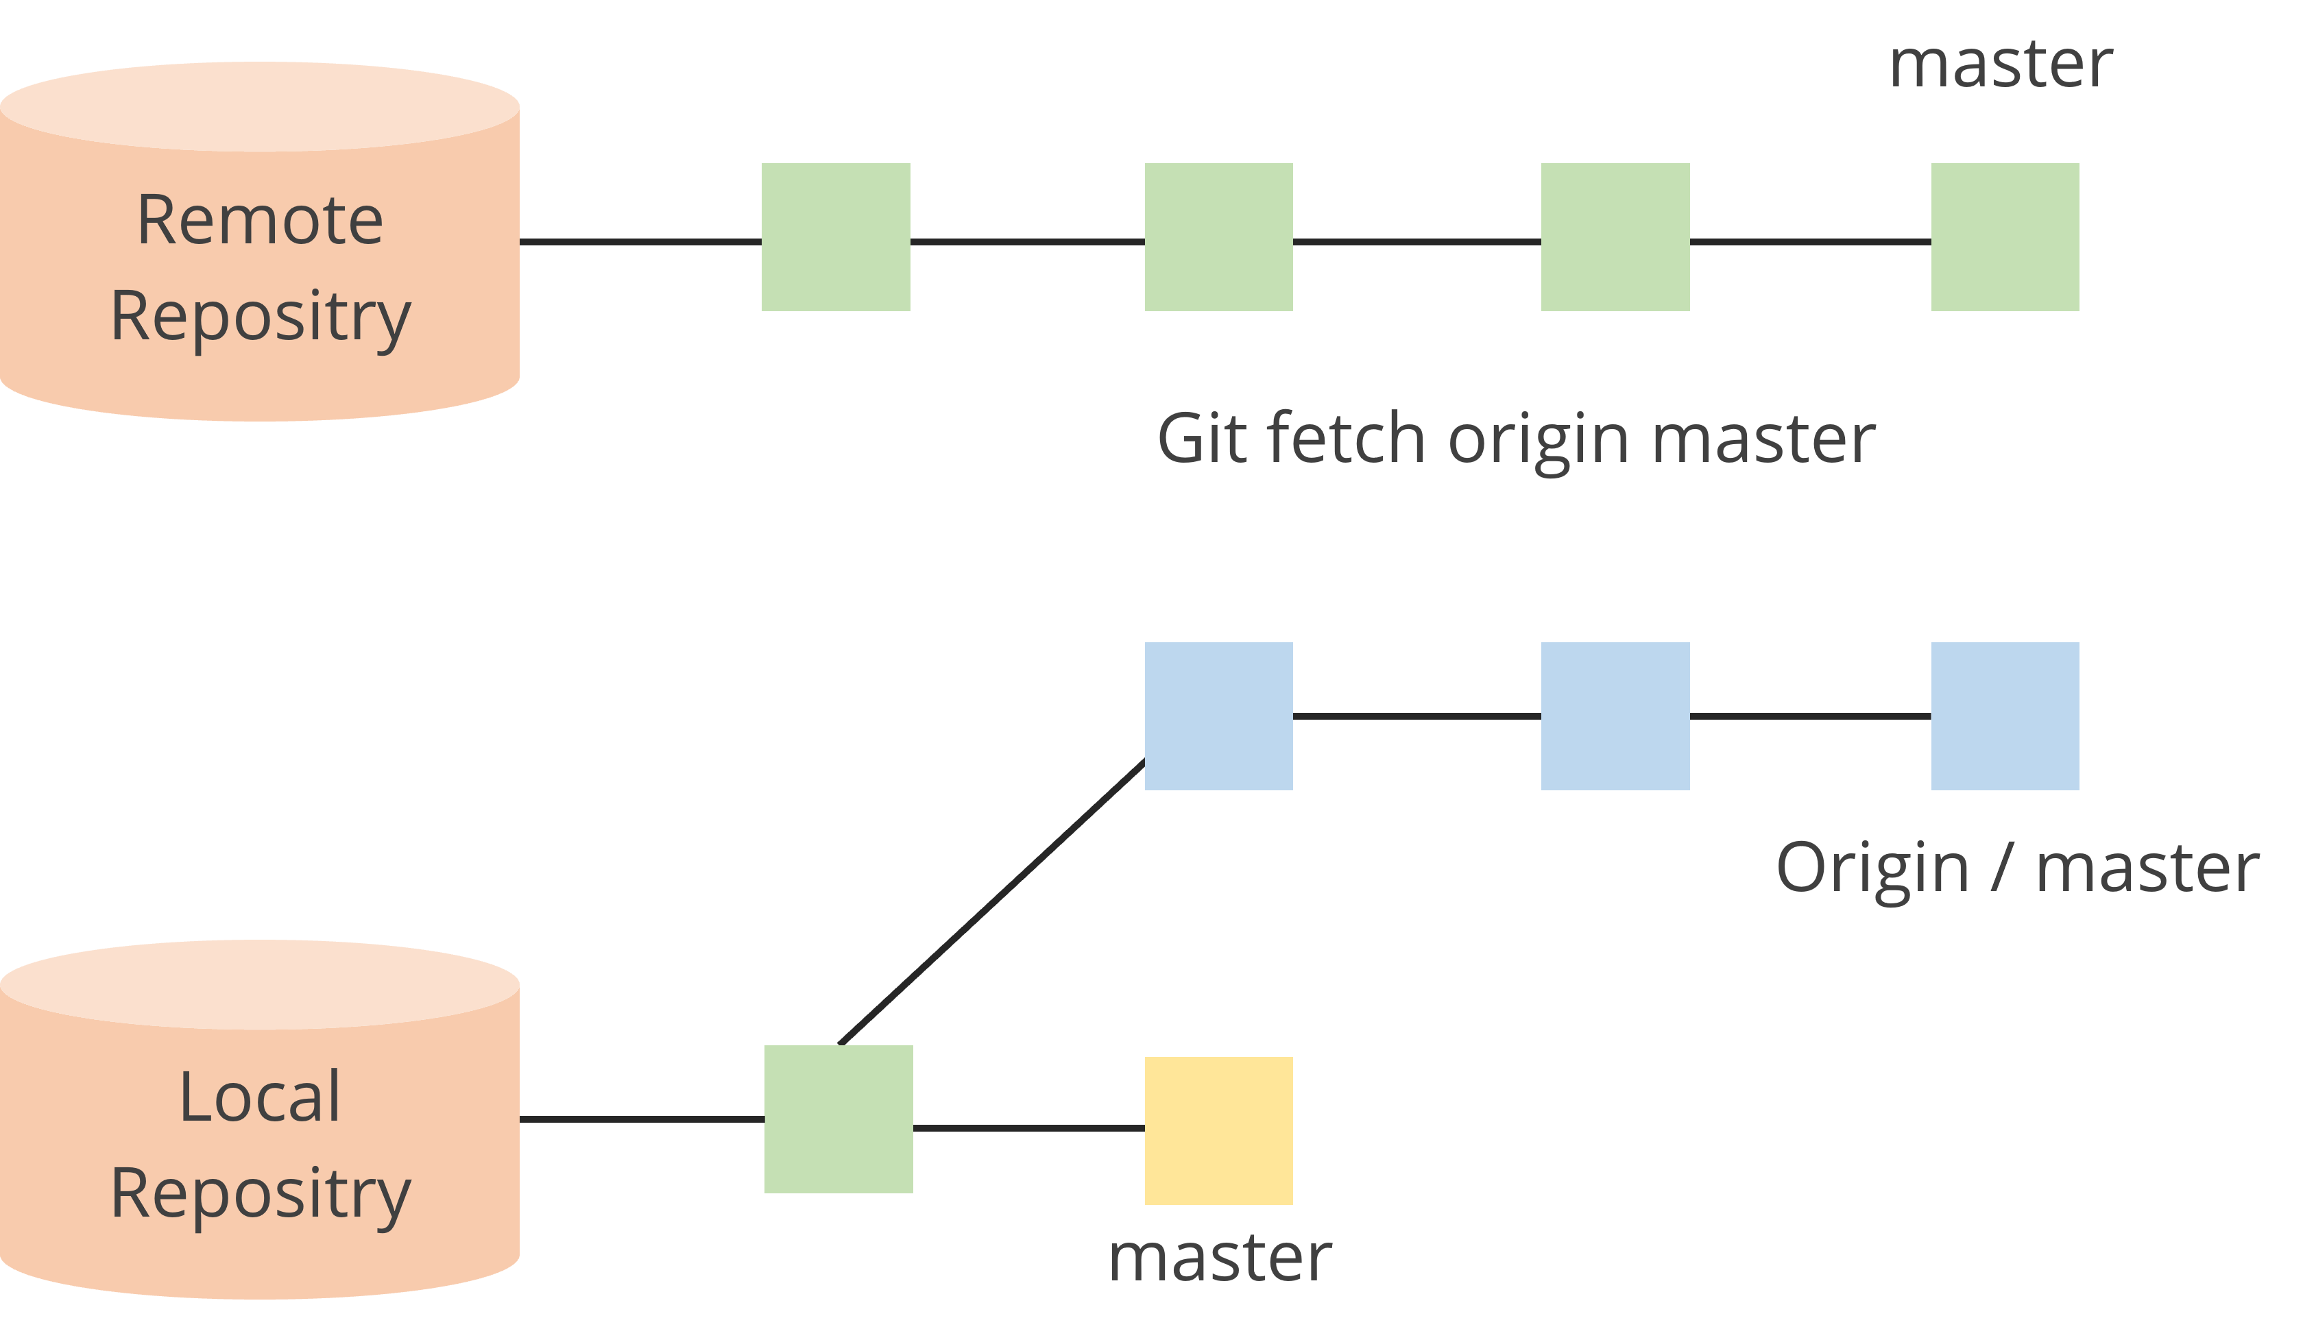
Git Fetch
The git fetch command downloads the latest commits, objects, and refs from the main branch of the remote Git repository in the local .git directory. This does not modify the working directory.
After reviewing the remote changes, the git merge origin/master command can be used to merge changes in the local repository.
Notes:
Instructor Note:
Remote Repository: This represents the central repository hosted on a Git server, containing the original or shared project files and history. In this case, it's named origin.
Master Branch: The master branch is the main branch in the remote repository, typically containing the most stable and tested code.
git fetch origin master: This command instructs Git to download the latest commits and branch information from the master branch of the origin remote repository.
Local Repository: This is your working directory on your local machine where you've cloned the Git repository. It contains a copy of the project files and a hidden .git directory that stores Git metadata.
origin/master: This is a local tracking branch that reflects the remote master branch. It keeps track of the remote branch's latest commit but doesn't contain the actual files.
Working:
git fetch downloads the latest commits, branches, and tags from the remote repository.
It stores this information in your local .git directory.
Your local working directory and your current branch remain untouched.
The updated remote tracking branch (origin/master) now points to the latest commit on the remote master branch.

Slide 47
Git Fetch
The following are the scenarios for using the git fetch command:
Fetch the complete remote repository
To fetch the complete remote repository of the codebase, the
git fetch <remote_repository_URL> command is used
Fetch a specific branch
To fetch a specific branch from a repository, the
git fetch <branch_URL> <branch_name> command is used
Fetch all branches
To fetch all the branches of a repository simultaneously, the
git fetch -all command is used
Fetch new updates
To add new updates from the codebase to the local repository, the git fetch origin command is used
Notes:
Instructor Note:
Explain these commands with use cases and examples.
Common Use Cases:
Reviewing Changes: Before merging updates, developers can fetch changes to see what modifications have been made in the remote repository.
Keeping Track of Remote Branches: Fetching helps to stay up-to-date with the branches available in the remote repository without affecting the local branches.
Examples:
Fetch from a specific branch: git fetch origin feature-branch to get updates from the feature-branch without merging.
Fetch all branches: git fetch --all retrieves all branches from the remote repository, useful for large projects with multiple branches.

Slide 48
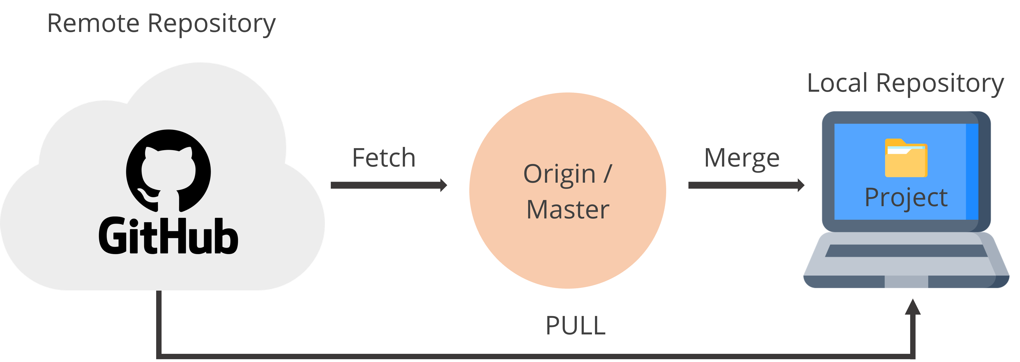
Git Pull
The git pull command integrates changes from a remote repository into the local working directory by performing fetching and merging.
Syntax
git pull <option> [<repository URL><refspec>...]
Notes:
Instructor Note:
In the syntax of Git pull command:
<option>: Options are the commands; these commands are used as an additional option in a particular command. Options can be -q (quiet), -v (verbose), -e(edit) and more.
<repository URL>: Repository URL is your remote repository's URL where you have stored your original repositories like GitHub or any other git service
<refspec>: A ref is referred to commit, for example, head (branches), tags, and remote branches. You can check head, tags, and remote repository in .git/ref directory on your local repository. Refspec specifies and updates the refs.

Slide 49
Push and Pull Workflow in Git
The following shows a typical workflow that occurs in Git for tracking and managing files using add, commit, push, and pull:
Remote Environment
Remote Repository
Push
Clone
Fetch
Local
Repository
Pull
Commit
Checkout
Staging Area
Add
Working
Directory
Local Environment
Notes:
Instructor Note:
The diagram helps us understanding the simple Git workflow of Add, Commit, Push, and Pull to manage the code and collaborate smoothly.

Slide 50
Forking in Git
It refers to creating a distinct and independent copy of a remote codebase. It allows developers to freely modify the code without affecting the original project.
To propose modifications or bug fixes without affecting the original project
Purpose of forking
To experiment with new features or explore different development paths
To create a customized version of the software while referencing the original code
Notes:
Instructor Note:
Forking creates a copy of an existing Git repository. This copy resides on a different server, typically under your own account on a Git hosting platform like GitHub or GitLab.
Why Fork?
There are several reasons why someone might fork a repository:
Propose Changes: If you have modifications or bug fixes you'd like to contribute to the original project, forking allows you to make changes in your own copy without affecting the main codebase. You can then submit a pull request to the original repository, proposing your changes for review and potential integration.
Experimentation: A fork serves as a safe space to test modifications or explore different development paths without altering the original project.
Personal Use: You can fork a repository to create a customized version for your own purposes while still referencing and benefiting from the original code.

Slide 51
Forking vs. Cloning
The following are the fundamental differences between forking and cloning a remote repository:
Forking
Cloning
Forking allows individuals to create a copy of the original project.
Cloning makes a local copy of the original project which developers do not own.
Forking is often used in open-source development.
Cloning is often used for development within an organization.
Forking does not affect the original repository.
Cloning maintains a direct connection to the original repository.
Notes:
Instructor Note:
In summary, forking creates an independent copy of a repository under your account, often used for collaborative contributions, while cloning creates a local copy on your machine for personal or team development, maintaining a direct link to the original repository.

Slide 52
What Is a Pull Request?
A pull request in Git is a method used to propose changes made to a codebase and request that they be merged into another branch, typically the main or master branch.
Create a pull request to propose changes
Review the proposed changes
Trigger continuous integration of code
Merge the pull request to the target branch
Resolve merge conflicts
Notes:
Instructor Notes:
Explain what is pull request and its importance. Take an example to explain its working.
Reference:
A pull request (PR) in Git is a method used to propose changes you've made to a codebase and request that they be merged into another branch, typically the main or master branch. Pull requests are commonly used in collaborative environments, particularly in platforms like GitHub, GitLab, and Bitbucket, to review and manage contributions to a repository.
Key Features of a Pull Request:
Propose Changes:
When you have completed a set of changes in a branch, you can create a pull request to propose merging these changes into another branch.
Example: You finish a feature in feature-branch and create a pull request to merge it into main.
Code Review:
Pull requests facilitate code reviews, allowing team members to discuss and review the proposed changes.
Reviewers can comment on specific lines of code, ask questions, and suggest modifications.
Continuous Integration (CI):
Pull requests often trigger automated tests and CI pipelines to ensure that the proposed changes do not introduce any errors or issues.
This helps maintain the quality and stability of the codebase.
Conflict Resolution:
If there are merge conflicts between the branches, they need to be resolved before the pull request can be merged.
This ensures that the integration is smooth and doesn't disrupt the existing code.
Approval and Merging:
Once the changes are reviewed and approved by the team, the pull request can be merged into the target branch.
The person with the necessary permissions can then merge the changes, often using options to create a merge commit or to squash and merge.

Slide 53
Creating a Pull Request
The following are the steps to create a pull request:
Fork the project repository
Clone the forked repository
Create a new local branch
Make changes to the codebase and commit those changes in the local branch
Push the branch with changes to the forked repository in GitHub
Go to the original repository on GitHub and open a pull request
Collaborate with the repository maintainers to review your pull request
Once approved, the maintainer merges the pull request
Notes:
Instructor Notes:
Explain the step given in detail.
Reference:
Steps to Create a Pull Request in Git
Fork the Repository:
Action: Click the "Fork" button on the original repository page on GitHub.
Outcome: A copy of the repository is created in your GitHub account.
Clone the Repository:
Action: Use git clone <repository-url> to clone the repository to your local machine.
Outcome: You have a local copy of the repository to work on.
Create a New Branch:
Action: Use git checkout -b <branch-name> to create and switch to a new branch.
Outcome: Changes are isolated in the new branch, keeping the main branch clean.
Make Changes and Commit:
Action: Edit the files as needed, then use git add <files> and git commit -m "commit message".
Outcome: Changes are recorded in your branch.
Push the Changes:
Action: Use git push origin <branch-name> to push your changes to GitHub.
Outcome: Your branch with changes is uploaded to your forked repository.
Open a Pull Request:
Action: Click "Compare & pull request" on GitHub.
Outcome: A pull request is created, proposing your changes to the original repository.
Review and Address Feedback:
Action: Discuss changes with maintainers, make necessary updates, and push them.
Outcome: Ensures the changes meet the project's requirements and standards.
Merge the Pull Request:
Action: Once approved, the maintainer merges the pull request.
Outcome: Your changes are integrated into the main branch of the original repository.

Slide 54
Assisted Practice
Duration: 10 Min.
Creating a pull request in Git
Problem statement:
You have been assigned a task to create a pull request for merging the local changes into a remote Git repository.
Outcome:
By completing this demo, you will gain proficiency in creating a pull request to merge local changes into a remote Git repository. You will learn how to fork a repository, clone the fork, sync it with the original repository, push changes to the fork, and create a pull request.
Note: Refer to the demo document for detailed steps
Notes:
Instructor Notes:
Refer to the demo document for detailed steps

Slide 55
Assisted Practice: Guidelines
Steps to be followed:
Create a fork
Clone the fork
Sync the fork with the original repository
Push changes to the GitHub fork
Create a pull request
Notes:
Instructor Notes:
Refer to the demo document for detailed steps

Slide 56
As a DevOps engineer, you've forked a repository to implement a new feature. After local changes, ensure your fork is up-to-date with the main repository before pushing and creating a pull request. What sequence of Git commands should you use to update your fork, push your changes, and create a pull request?
git pull, git push origin master, create a pull request
git fetch upstream, git merge upstream/master, git push origin master, create a pull request
git clone [repository URL], git pull, git push, create a pull request
git fetch origin, git rebase origin/master, git push origin, create a pull request
Notes:
Mode: Sync
Estimated duration: 5 minutes
Instructor Note:
Conduct the poll and, if necessary, reteach key points based on the results before starting with the next topic.
Provide feedback or explanations after the poll, where appropriate, so learners can understand why certain answers are correct or incorrect.
If most of the class is getting the poll incorrect, then there is a gap in their understanding. Prompt the learners to highlight which concepts are unclear to them and teach those topics for the understanding of the whole class. Move onto the next topic when the class is confident in their understanding of the section.
Correct Answer: C. git fetch upstream, git merge upstream/master, git push origin master, create a pull request
Explanation: This sequence ensures that your fork is updated with the latest changes from the main repository before pushing your changes and creating a pull request.

Slide 57
Branching and Merging in Git
Notes:
Instructor Notes:
Let us now understand branching and merging in Git

Slide 58
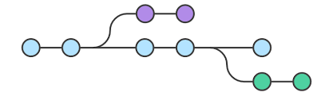
Branching in Git
A Git branch is a lightweight movable pointer to the commits. It allows developers to create isolated copies of the codebase at specific points of the development line within the project.
Release branch
Main branch
Developer branch
It enables the developers to experiment with new features, fix bugs, or collaborate on different parts of the project without affecting the main codebase.
Notes:
Instructor Note:
Branching is a fundamental concept in Git version control that allows you to create isolated lines of development within your project. It essentially creates copies of your codebase at specific points in time, enabling you to experiment with new features, fix bugs, or collaborate on different parts of the project without affecting the main codebase.

Slide 59
Purpose of Branching
The primary purpose of branching in Git is to create isolated environments for development within the project. Additionally, here are some key reasons to use branches:
Experimentation and feature development: It provides developers with separate space to test and experiment with new software features.
Collaboration and parallel development: It allows developers to work simultaneously without conflicts or overwriting.
Version control and code history: It allows tracking of changes, reverting to previous versions, and understanding the evolution of the codebase.
Deployment strategies: It can be used to create separate environments for deployment purposes.
Notes:
Instructor Note:
In essence, branching provides a safe and organized way to:
Isolate development efforts: Experiment and make changes without affecting the main codebase.
Facilitate collaboration: Enable multiple developers to work on different parts of the project.
Maintain a clean code history: Track changes and revert to previous versions if needed.
Implement deployment strategies: Create separate environments for testing and production.

Slide 60
Operations in Branching
Operations | Description
Create a branch | The first step is to create a branch from the main branch of the codebase.
Merge a branch | The merging of branches is done after working on a specific feature.
Delete a branch | An existing branch can be deleted when the branch has done its job.
Checkout a branch | It refers to switching from one branch to another in a remote repository.
Notes:
Instructor Note:
Create a Branch: This is the first step in the process, you can start on a default branch or create a new branch for the development.
Merge A Branch: An already running branch can merge with any other branch in your Git repository. Merging a branch can help when you are done with the branch and want the code to integrate into another branch code.
Delete A Branch: An already running branch can delete from your Git repository. Deleting a branch can help when the branch has done its job, i.e., it’s already merged, or you no longer need it in your repository for any reason.
Checkout A Branch: An already running branch can pull or checkout to make a clone of the branch so that the user can work on any of them. Pulling a branch can help when you don’t want to disturb the older branch and experiment on the new one.

Slide 61
Branch Commands
$ git branch <branch name>
Creates a new branch
$ git branch
Lists all branches in the
current repository
$ git checkout <branch name>
Switches to different branches
$ git merge <branch name>
Merges two branches
NOTE
To create a new branch and switch to it, execute: $ git checkout -b<branch-name>
Notes:
Instructor Note:
Creating a Branch:
Command: git branch <branch name>
Purpose: This command creates a new branch with the specified name. However, it doesn't switch to the new branch immediately.
Listing Branches:
Command: git branch
Purpose: This lists all the branches in the current repository. The current branch is indicated with an asterisk (*).
Switching Branches:
Command: git checkout <branch name>
Purpose: This switches to the specified branch, updating the working directory to match the branch's state.
Merging Branches:
Command: git merge <branch name>
Purpose: This merges the specified branch into the current branch, integrating the changes from the specified branch.
Creating and Switching to a New Branch:
Command: git checkout -b <branch name>
Note: This is a shortcut that creates a new branch and switches to it in one step, combining the creation and checkout commands.

Slide 62
Assisted Practice
Duration: 10 Min.
Creating a branch in Git
Problem statement:
You have been assigned a task to create a branch in a Git repository to facilitate a collaborative and organized approach to software development
Outcome:
By completing this demo, you will gain proficiency in facilitating a collaborative and organized approach to software development. You will create and manage branches in a Git repository, including creating a new GitHub repository, cloning it, listing all branches, creating a new branch, and deleting a branch.
Note: Refer to the demo document for detailed steps
Notes:
Instructor Notes:
Refer to the demo document for detailed steps

Slide 63
Assisted Practice: Guidelines
Steps to be followed:
Create a new GitHub repository
Clone the GitHub repository
List all the branches in your repository
Create a new branch
Delete the branch
Notes:
Instructor Notes:
Refer to the demo document for detailed steps

Slide 64
Switching Branches in Git
Switching branches in Git is a fundamental concept for managing the development workflow. It isolates the changes that the developer is working on and seamlessly switches between different functionalities.
There are two Git commands that are used to switch between branches:
git checkout
git switch
This command enables the switching of branches by updating the files in the working tree to match the version stored in the desired branch.
This command enables switching the current HEAD branch. It's a relatively new feature, offering a simpler alternative to the traditional checkout command.
Notes:
Instructor Note:
In Git, both git checkout and git switch can be used to change branches, but there are some subtle differences:
Functionality: They both achieve the same outcome of switching branches, but git checkout has additional functionalities beyond branch switching.
Focus: git switch is a newer, more specialized command designed specifically for switching and managing branches (including creating new branches).
Versatility: git checkout is a more versatile tool that can also be used for:
Restoring files from a specific commit.
Detaching your HEAD from any branch.
Updating submodules (external projects linked into your Git repository).
Safety: The git switch might be considered safer for switching branches because it avoids some potential confusion with git checkout's other functionalities.

Slide 65
Switching Branches in Git
The following are the Git commands to switch between branches within a Git repository:
Git operations | git checkout | git switch
To switch from one branch to another | git checkout <branchname> | git switch <branchname>
To create a new branch and switch to it | git checkout -b <branchname> | git switch -c <branchname>
Notes:
Instructor Note:
Switching to an existing branch
Command:
git checkout <branch_name>
git switch <branch_name> (recommended for newer Git versions)
Example: You're working on your develop branch and want to switch to the feature/login branch to implement a login functionality.
git checkout feature/login
git switch feature/login
Creating a new branch and switching to it simultaneously
Command:
git checkout -b <new_branch_name>
git switch -c <new_branch_name> (alternative)
Example: You're on the develop branch and want to create a new branch named fix/bug123 to address a specific bug.
git checkout -b fix/bug123 (creates the branch and switches to it)
git switch -c fix/bug123 (alternative command)

Slide 66
Assisted Practice
Duration: 10 Min.
Switching branches in Git
Problem statement:
You have been assigned a task to demonstrate how to switch branches in Git to understand the branch management and version control workflows in GitHub.
Outcome:
By completing this demo, you will gain proficiency in understanding branch management and version control workflows in GitHub. You will create a new repository, clone it, list all branches, create and switch to a new branch, commit changes, and switch back to the main branch.
Note: Refer to the demo document for detailed steps
Notes:
Instructor Notes:
Refer to the demo document for detailed steps

Slide 67
Assisted Practice: Guidelines
Steps to be followed:
Create a new GitHub repository
Clone the GitHub repository
List all the branches in your repository
Create and switch to the new branch
Create a file and commit the changes
Switch back to the main branch
Notes:
Instructor Notes:
Refer to the demo document for detailed steps

Slide 68

Merging Branches in Git
Merging branches in Git is a technique for integrating changes from different development lines into a single branch.
The Git merge combines multiple sequences of commits into one unified history. In most of the cases, git merge is used to combine two branches.
Master tip
Master tip
New merge
commit
Common
base
Common
base
Feature tip
Feature tip
Before merging
After merging
Notes:
Instructor Note:
Merging branches in Git is a fundamental technique for integrating changes from different development lines into a single branch. Here's a breakdown of the concept:
What is Merging?
Merging combines the history of two or more branches into a single branch.
Imagine it like merging two streams into a wider river. The resulting flow incorporates the content from both branches.
It is mainly used for:
Feature Development: Developers often work on features in separate branches to isolate their changes. Merging allows you to integrate these completed features back into the main codebase.
Bug Fixes: Hotfixes or bug fixes created in dedicated branches need to be merged into the main branch to ensure everyone has the fix.

Slide 69
Merging Branches in Git
The following shows the process of merging branches in a Git repository:
Identify branches
Switch branches
Merge command
Resolve conflicts
Commit merge
Determine the branches to merge
Use git
checkout or
git switch
Run the git merge <branch_name> command
Resolve the merge conflicts
Stage the changes and commit the merge
Notes:
Instructor Notes:
The Merge Process:
Identify Branches: Determine the branch you want to merge into (usually the main branch) and the branch containing the changes you want to integrate (feature branch).
Switch Branches: Use git checkout or git switch to navigate to the branch where you want the merge to happen (typically the main branch).
Merge Command: Run the git merge <branch_name> command, specifying the branch containing the changes you want to integrate.
Potential Conflicts: Git attempts to automatically merge the changes. If there are conflicts (overlapping changes), you'll need to manually resolve them by editing the files.
Commit the Merge: Once conflicts are resolved (if any), stage the changes and commit the merge with an appropriate message.

Slide 70
Assisted Practice
Duration: 10 Min.
Merging branches in Git
Problem statement:
You have been assigned a task to demonstrate how to merge branches in Git to integrate changes from one branch into another while maintaining a cohesive codebase and version history
Outcome:
By completing this demo, you will gain proficiency in merging branches within a Git repository. You will create a new GitHub repository, clone it, list branches, create and switch to a new branch, make and commit changes, check branch status, switch back to the main branch, and merge branches.
Note: Refer to the demo document for detailed steps
Notes:
Instructor Notes:
Refer to the demo document for detailed steps

Slide 71
Assisted Practice: Guidelines
Steps to be followed:
Create a new GitHub repository
Clone the GitHub repository
List all the branches in your repository
Create and switch to the new branch
Create a file and commit the changes
Check the status of the new branch
Switch back to the main branch
Merge the branches
Notes:
Instructor Notes:
Refer to the demo document for detailed steps

Slide 72
Merge Conflicts in Git
Merging branches in Git integrates changes into the codebase, but sometimes conflicts arise when different branches modify the same lines of code.
Conflicts occur when Git encounters changes made to the same lines of code in separate branches while merging.
Git cannot automatically decide which version to keep, so it flags the conflict and requires manual intervention.
Reasons for merge conflicts
Notes:
Instructor Note:
Merging branches in Git is a great way to integrate changes, but sometimes conflicts arise when different branches modify the same lines of code. Here's how to tackle these merge conflicts:
Understanding Merge Conflicts:
Conflicts occur when Git encounters changes made to the same lines of code in separate branches you're trying to merge.
Git can't automatically decide which version to keep, so it flags the conflict and requires manual intervention.
Spotting Conflicts:
After attempting a merge using git merge <branch_name>, Git will signal conflicts by displaying markers in the affected files. These markers typically include lines like <<<<<<<, =======, and >>>>>>>, indicating the different versions from each branch.

Slide 73
Assisted Practice
Duration: 10 Min.
Resolving merge conflicts in Git
Problem statement:
You have been assigned a task to demonstrate how to merge branches in Git to integrate changes from one branch into another while maintaining a cohesive codebase and version history.
Outcome:
By completing this demo, you will gain proficiency in seamlessly integrating branch changes in Git, ensuring a cohesive codebase and version history.
Note: Refer to the demo document for detailed steps
Notes:
Instructor Notes:
Refer to the demo document for detailed steps

Slide 74
Assisted Practice: Guidelines
Steps to be followed:
Create a new GitHub repository
Clone the GitHub repository
List all the branches in your repository
Create and switch to the new branch
Create a file and commit the changes
Check the status of the new branch
Switch back to the main branch
Merge the branches
Notes:
Instructor Notes:
Refer to the demo document for detailed steps

Slide 75
You've been working on a bug fix in a separate branch that is ready to merge into the develop branch. After running git merge develop, the terminal displays a bunch of code with markers like <<<<<<< and >>>>>>>. What should be done next?
These markers indicate a successful merge. Commit the changes with a descriptive message.
Stash the uncommitted changes from the bug fix branch and switch back to the develop branch.
Manually edit the files to resolve the conflicts, remove the markers, and then commit the merge.
Ignore the markers and commit the merge anyway. Most likely they won't cause any issues.
Notes:
Mode: Sync
Estimated duration: 5 minutes
Instructor Note:
Conduct the poll and, if necessary, reteach key points based on the results before starting with the next topic.
Provide feedback or explanations after the poll, where appropriate, so learners can understand why certain answers are correct or incorrect.
If most of the class is getting the poll incorrect, then there is a gap in their understanding. Prompt the learners to highlight which concepts are unclear to them and teach those topics for the understanding of the whole class. Move onto the next topic when the class is confident in their understanding of the section.
Correct Answer: C. Manually edit the files to resolve the conflicts, remove the markers, and then commit the merge.
Explanation: The markers (<<<<<<< and >>>>>>>) indicate conflicting code sections from your bug fix branch and the develop branch. Git couldn't automatically merge them, so you need to manually intervene and decide which changes to keep or integrate to create a working version.

Slide 76
Undoing and Inspecting Changes in Git
Notes:
Instructor Notes:
Let us now discuss Undoing and Inspecting Changes in Git
Mode: Sync
Estimated duration: 10-15 minutes
Type: Instructor-led

Slide 77
Undoing and Inspecting Changes in Git
These are essential tasks for managing project revisions effectively. Below are the methods to undo and inspect changes in Git:
Git Revert
Git Reset
Git rm command
Git diff
Git Status command
Notes:
Instructor Notes:
List of Methods:
The slide lists five key Git commands used for undoing and inspecting changes:
Git Revert
Git Reset
Git rm command
Git diff
Git Status command
Details of Each Method:
Git Revert
Purpose: This command creates a new commit that undoes the changes of a previous commit. It’s a safe way to undo changes as it preserves the history.
Example: Useful when a specific commit needs to be reversed without altering the subsequent commits.
Git Reset
Purpose: This command can move the current branch to a different commit and has different modes (soft, mixed, hard) that determine what happens to the index and working directory.
Example: Often used to unstage changes (with --soft) or to completely wipe changes from the working directory (with --hard).
Git rm command
Purpose: This command is used to remove files from the working directory and the index.
Example: Handy when a file needs to be deleted from both the staging area and the working directory.
Git diff
Purpose: This command shows the differences between commits, working directory, and staging area. It is crucial for inspecting changes before committing them.
Example: Commonly used to review changes that have been made but not yet committed.
Git Status command
Purpose: This command displays the state of the working directory and the staging area. It shows which changes have been staged, which haven’t, and which files aren’t being tracked by Git.
Example: Typically used to get a summary of the current state of the repository.

Slide 78
Git Revert
It is a Git command that generates a new commit to revert changes made in a repository, effectively undoing prior commits.
Syntax:
Here, <commit-hash> is the identifier of the commit you want to revert.
This command generates a new commit that reverses the changes made by a specified commit, effectively restoring the previous state while maintaining the commit history.
Git Create tag
git revert <commit-hash>
Git List tag
Notes:
Instructor Notes:
The syntax box shows the command format, where <commit-hash> is a placeholder for the unique identifier of the commit to be reverted.
First Point:
"Here, <commit-hash> is the identifier of the commit you want to revert."
Explanation: Clarifies that the commit hash uniquely identifies the specific commit to be reverted.
Second Point:
"This command generates a new commit that reverses the changes made by a specified commit, effectively restoring the previous state while maintaining the commit history."
Explanation: Emphasizes that Git revert creates a new commit to reverse the changes, ensuring that the commit history remains intact. This is crucial for preserving the integrity of the project's history, unlike git reset, which can rewrite commit history.
Additional Speaker Notes:

Slide 79
Git Revert Options
Git revert command provides various options to customize the undo operation according to specific requirements, including:
Commit identifier
To revert changes, specify the commit identifier of the changes you want to undo.
Git Create tag
Multiple commits
Git revert allows reverting changes from multiple commits simultaneously by specifying their commit hashes.
Selective revert
Git List tag
You can selectively undo specific changes within a commit by staging or unstaging particular files or lines before executing the revert command.
Notes:
Instructor Notes:
These options provide flexibility and control over the undo process, enabling developers to effectively manage changes and maintain the integrity of the project history.

Slide 80
Git Revert Options
Reverting merge commits
Git revert can handle reverting changes introduced by merge commits as well, ensuring flexibility in handling complex scenarios.
Git Create tag
Dry run
Git revert implementations offer a dry run feature, enabling the previewing of changes before committing them to the repository.
Git List tag
Notes:
Instructor Notes:
These options provide flexibility and control over the undo process, enabling developers to effectively manage changes and maintain the integrity of the project history.

Slide 81
Git Reset
It is the command that users use when they want to move the repository back to a previous commit, discarding any changes made after that commit.
Syntax:
Git Create tag
Here,
options: Additional options for reset, such as --soft, --mixed, or --hard
<commit>: The commit to which the HEAD should be moved. If omitted, defaults to HEAD
<paths>: Optional path(s) to limit the reset operation to specific files or directories.
git reset [options] [<commit>] [--] <paths>
Git List tag
Notes:
Instructor Notes:
Git reset is a versatile command used to manipulate the state of a Git repository.
Understanding Git reset is crucial for managing changes and maintaining a clean project history within a Git repository.

Slide 82
Git Reset
Git reset can function on entire commit objects or at a file level. These different reset options impact particular trees managed by Git to handle your file and its contents.
--Mixed
It has three core invocation forms:
Soft
Mixed
Hard
Working
Directory
Commit
History
Git List tag
--Soft
--Hard
Notes:
Instructor Notes:
Git Reset Hard: It will first move the Head and update the index with the contents of the commits. It is the most direct, unsafe, and frequently used option. The --hard option changes the Commit History, and ref pointers are updated to the specified commit. Then, the Staging Index and Working Directory need to reset to match that of the specified commit. Any previously pending commits to the Staging Index and the Working Directory gets reset to match Commit Tree. It means any awaiting work will be lost.
Git Reset Mixed: A mixed option is a default option of the git reset command. If we would not pass any argument, then the git reset command considered as --mixed as default option. A mixed option updates the ref pointers. The staging area also reset to the state of a specified commit. The undone changes transferred to the working directory
Git Reset Head (Git Reset Soft): The soft option does not touch the index file or working tree at all, but it resets the Head as all options do. When the soft mode runs, the refs' pointers updated, and the resets stop there. It will act as git amend command
Git is a tool that resets the current state of HEAD to a specified state. It is a sophisticated and versatile tool for undoing changes. It acts as a time machine for Git. You can jump up and forth between the various commits. Each of these reset variations affects specific trees that git uses to handle your file in its content.
Additionally, git reset can operate on whole commits objects or at an individual file level. Each of these reset variations affects specific trees that git uses to handle your file and its contents.
Git uses an index (staging area), HEAD, and working directory for creating and reverting commits.

Slide 83
Git Remove
The git rm command removes files from both the working directory and the index (staging area) in Git, making it useful for erasing files from a repository's history.
Syntax:
Git Create tag
Here,
[options]: Additional options for the Git rm command, which can modify its behavior
<file(s)>: Specifies the file(s) to be removed from both the working directory and the index (staging area)
git rm [options] <file(s)>
Git List tag
Notes:
Instructor Notes:
The Git Remove (git rm) is a versatile command for managing files in a Git repository, providing options to remove files from both the working directory and the index, thus affecting the repository's history.

Slide 84
Git Remove
It offers several use cases, which include:
Supporting wildcards
Removing untracked files
01
03
Git Create tag
02
04
Removing files from the index
Staging deletions
Notes:
Instructor Notes:
1. Removing Untracked Files: Use git rm <file> to remove untracked files from both the working directory and the index
2. Staging Deletions: By default, git rm stages the file deletion, so you need to commit the change to complete the removal process.
3. Removing Files from the Index Only: You can use the --cached option to remove a file from the index without deleting it from the working directory.
4. Wildcard Support: git rm supports wildcards to remove multiple files that match a specific pattern.

Slide 85
Git Diff
This command displays distinctions between the working directory and the staging area, between the staging area and the last commit, and between commits, branches, or other Git objects.
Syntax:
Here,
options: Parameters that modify git diff's behavior, like --cached, --stat, and --color
commit: Specifies a commit to compare changes against, including hashes, branch names, or Git references
path: Optional path(s) limiting output to changes in specific files or directories
01
03
Git Create tag
git diff [<options>] [<commit>] [--] [<path>...]
02
04
Notes:
Instructor Notes:
The git diff command in Git is used to display the differences between the changes made in the working directory and the staging area (index), or between the staging area and the last commit, or even between two commits, branches, or any other Git objects.
It provides a detailed view of what has been modified, added, or deleted in the files.
For example, to see the changes between the working directory and the staging area, you can use git diff. To compare the changes between two commits, you can use git diff <commit1> <commit2>. Additionally, you can use various options like --cached to compare against the staging area, --stat to show statistics instead of full changes, and more.

Slide 86
Git Status
The git status command is used to show the status of the Git repository. It displays the state of the local directory and the staging area.
01
03
Syntax:
Git Create tag
$ git status
02
04
Notes:
Instructor Notes:
This command is useful for understanding what changes have been made and what actions need to be taken next, such as committing changes or staging new files. By running git status, users can ensure they have a clear understanding of the status of their repository before proceeding with further actions.

Slide 87
As a developer, you have been updating a web application. You notice that recent changes in your code have caused errors. To revert your files to how they were at the last commit, which Git command should you use?
git diff
git rm
git status
git reset --hard
Notes:
Mode: Sync
Estimated duration: 5 minutes
Instructor Note:
Conduct the poll and, if necessary, reteach key points based on the results before starting with the next topic.
Provide feedback or explanations after the poll, where appropriate, so learners can understand why certain answers are correct or incorrect.
If most of the class is getting the poll incorrect, then there is a gap in their understanding. Prompt the learners to highlight which concepts are unclear to them and teach those topics for the understanding of the whole class. Move onto the next topic when the class is confident in their understanding of the section.
Correct Answer: D) git reset --hard
Explanation: The git reset --hard command is used to reset the current HEAD to the specified state, undoing both staged and working directory changes to match the last commit. It is a powerful command that reverts the repository to a previous state and can discard local changes, making it ideal when you need a clean slate or to undo recent changes that have not been pushed.

Slide 88
A source code management system is used to track modifications to a source code repository and facilitate collaboration among development teams.
Version control systems track changes to files over time, enabling collaboration and rollback.
Git is an open-source distributed version control system used for tracking changes in source code during software development.
Git snapshots are like a miniature file system, with a set of snapshots of every commit.
A Git repository serves as a central storage location that records and tracks changes made to a collection of files.
The primary purpose of branching in Git is to create isolated environments for development within the project.
Notes:
Mode: Sync
Estimated duration: 5 mins
Type: Instructor-led activity

Slide 89
Implementing Basics of Version Control System with Git
Duration: 25 Min.
Project agenda: To create a remote GitHub repository and use Git commands to perform various version control operations for managing the remote repository
Description: You work as a developer in an IT firm. Your company is undertaking a project that consists of three modules, and you have been asked to work on one of these modules. You have also been instructed to upload all the project files to the GitHub repository. To avoid impacting the main codebase, create a new branch and conduct your work there. Once your module is complete, merge it into the main branch.
Notes:
Instructor Notes:
Refer to the lesson-end project solution document for detailed steps

Slide 90
Implementing Basics of Version Control System with Git
Duration: 25 Min.
Perform the following:
Create a new repository
Clone the GitHub repository
Create a new branch and verify it
Rename the existing branch and list all the branches
Create a new branch and switch to the new branch
Create a file, commit the changes, and check the status of the new branch
Delete the branch and verify it
Switch back to the main branch and merge
Expected deliverables: A step-by-step guide to creating, managing, and deleting branches and files in a Git repository, including scripts and commands to streamline version control for collaborative development
Notes:
Instructor Notes:
Refer to the lesson-end project solution document for detailed steps

Slide 91
Thank You

